Slide 1
What is Deep Learning
A class of machine learning techniques that exploit many layers of non-linear information processing for supervised or unsupervised feature extraction and transformation and for pattern analysis and classification.
It typically uses deep artificial neural networks.

Slide 2
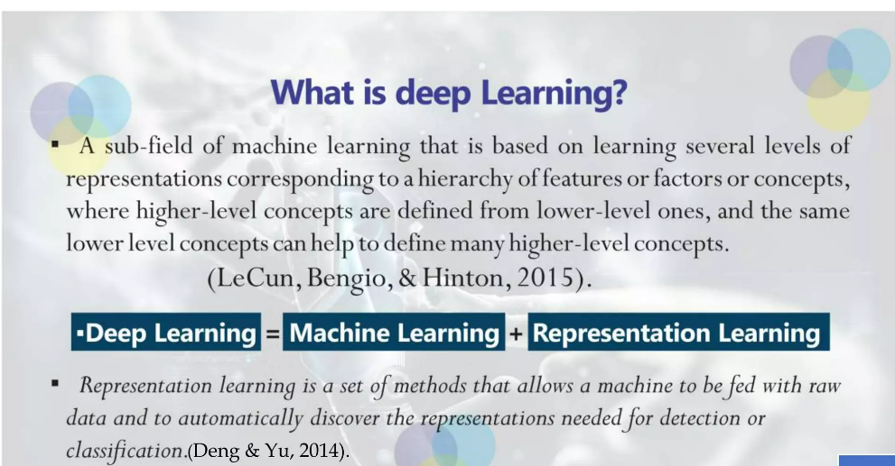

Slide 3
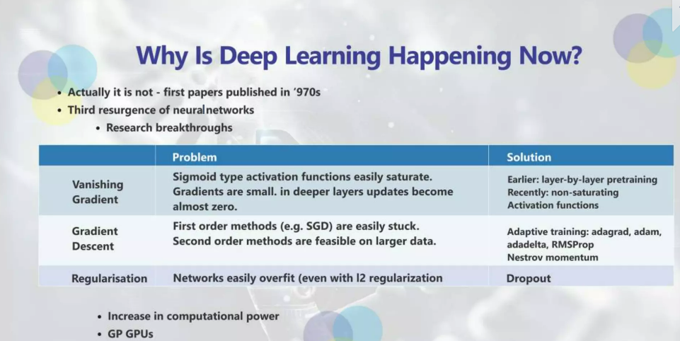

Slide 4
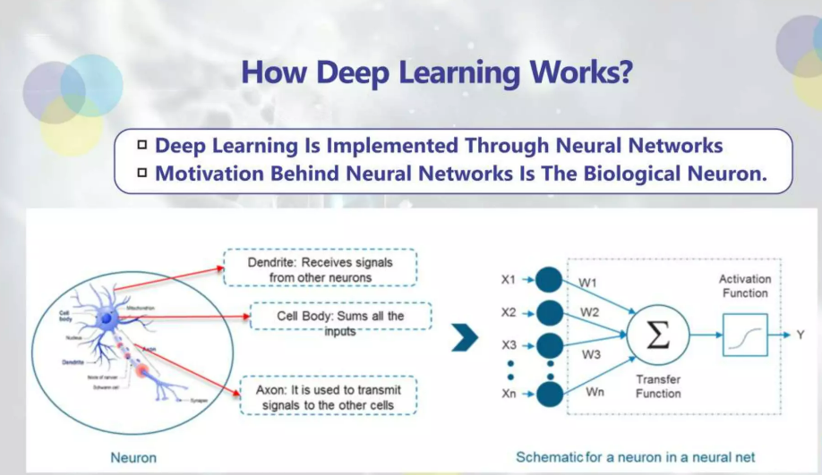

Slide 5
Unique Characteristics of Deep Learning
Automatic feature extraction
Makes use of high dimensional data for training
Defines higher level features from lower level features obtained from the previous layer
It is a representation learning method
Can solve real-world or unconstrained problems such as NLP, image recognition etc.

Slide 6
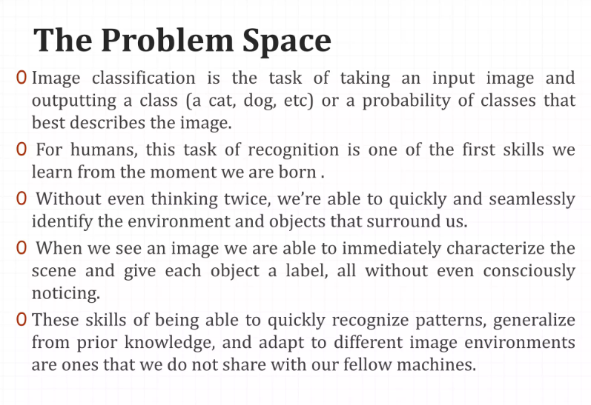

Slide 7
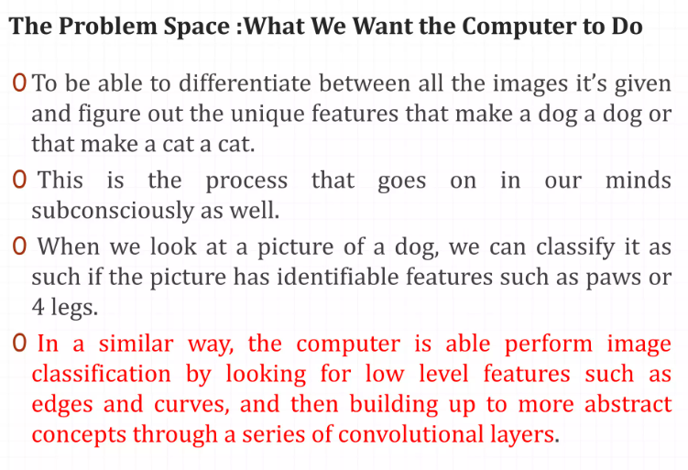

Slide 8
Deep Learning applications
1. Internet & Cloud
Image captioning, speech recognition, language translation, language processing, sentiment analysis, recommendation system.
2. Medicine & Biology
Drug discovery, Cancer cell detection
Media & Entertainment
Video captioning, video search, real time translation
Security & Defence
Face detection, video surveillance, satellite imagery
Autonomous machines
Pedestrian detection, lane tracking, recognise traffic signs

Slide 9
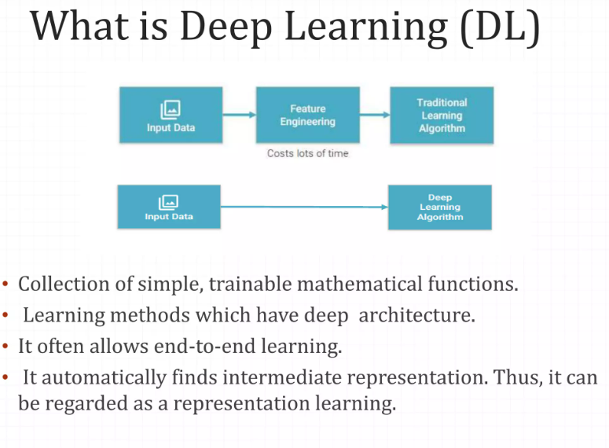

Slide 10
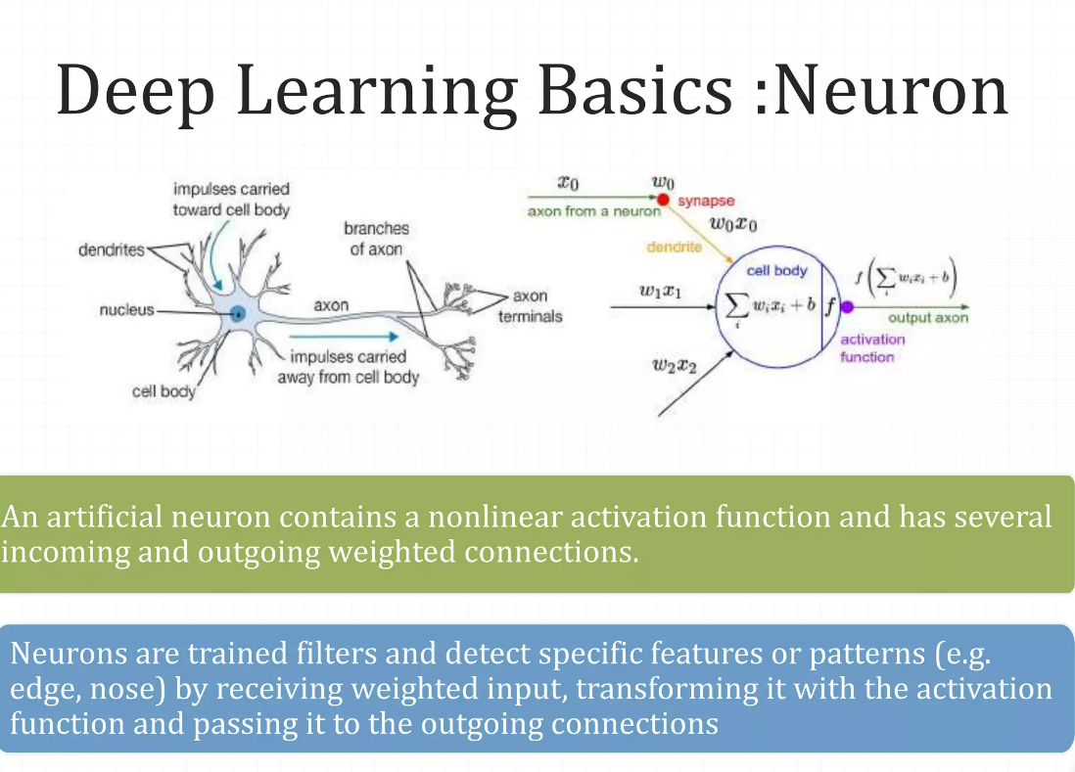

Slide 11
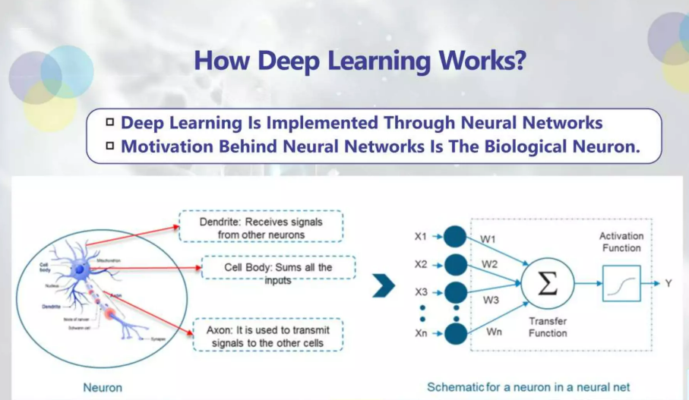

Slide 12
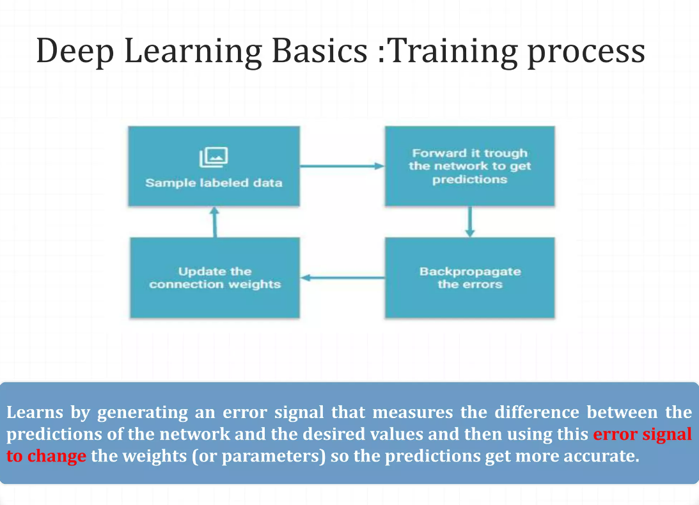

Slide 13
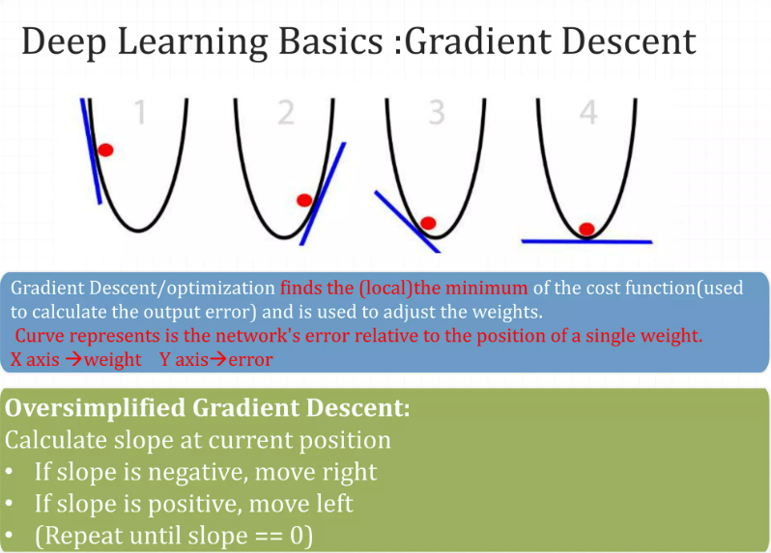

Slide 14
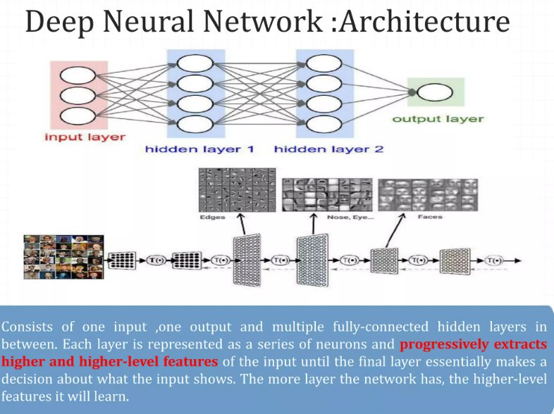

Slide 15
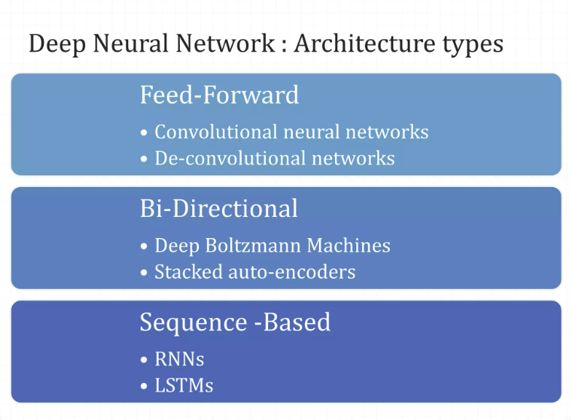

Slide 16
Review questions
==============
What is DL, characteristics of DL
Feature extraction and feature representation learning, difference between them
Motivation behind DL. Similarity between biological neuron and neural network concept
Vanishing gradient problem
Architecture types

Slide 17
Thank You
- Prepared by
Jheelam Mondal
Assistant Professor
CSE Department
Haldia Institute of Technology

